Slide 1

DATS 6101:
Team 1
Project 2 on
NASA - Nearest Earth Objects (NEO)
By Tyler Wallett, Anushka Vuppala and David Li

Slide 2
Outline
Project 1 refresher
SMART Question & Dataset
Feature Selection
Splitting and Sampling Techniques
Model 1: K-Nearest Neighbors (KNN)
Model 2: Logistic Regression
Model 3: Decision Tree
Conclusion
Sample Prediction

Slide 3



Project 1 refresher
NASA Dataset + NEO’s a.k.a. fancy way of saying asteroids + DART/ Elon Musk!?

Slide 4
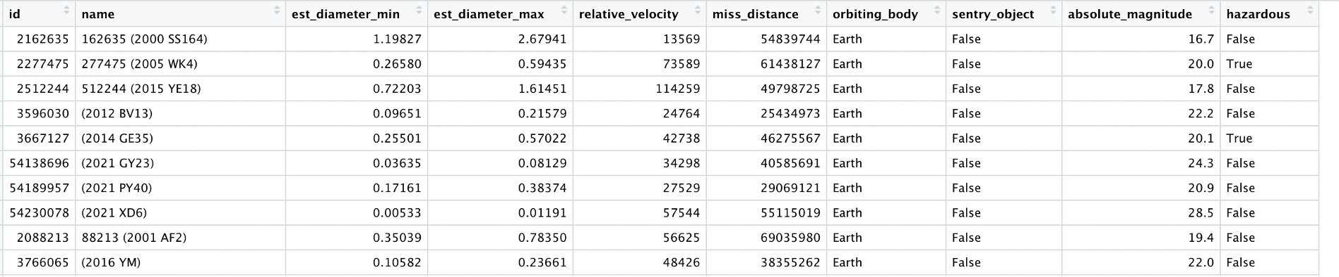
SMART Question & Dataset
Based on 22 years of nearest earth objects (neo) data, can we successfully predict whether an asteroid is hazardous or not? Moreover, how accurate will our predictions be?

Slide 5
Feature Selection

Slide 6
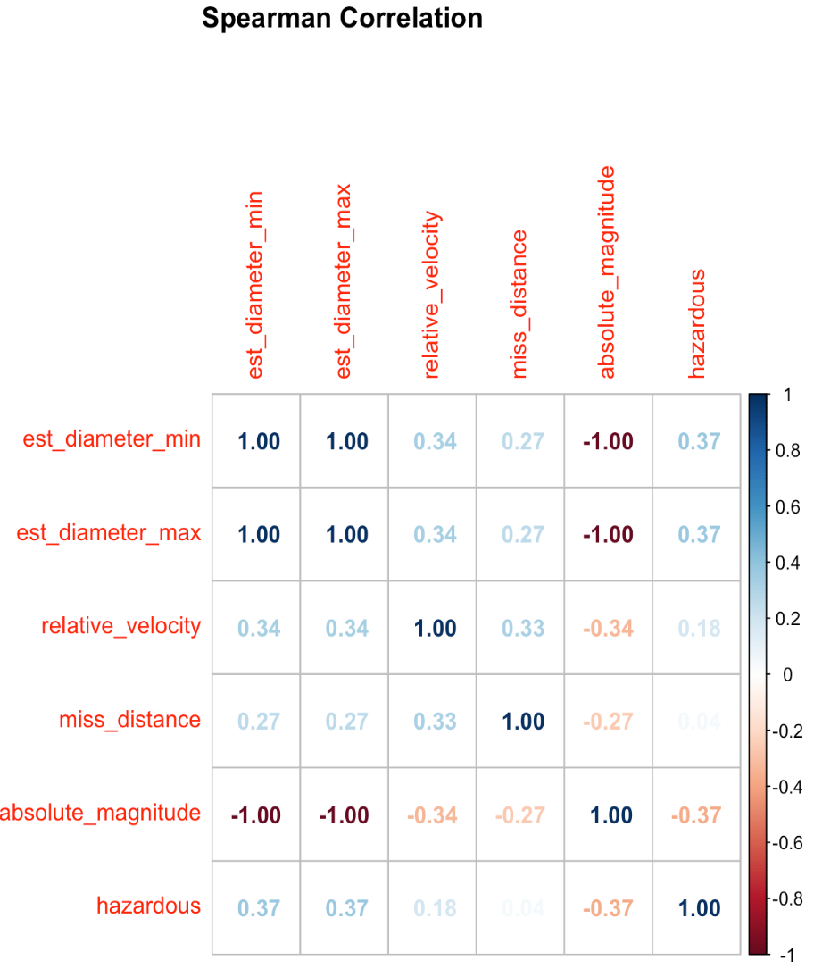
Feature Selection: Spearman correlation matrix

Slide 7
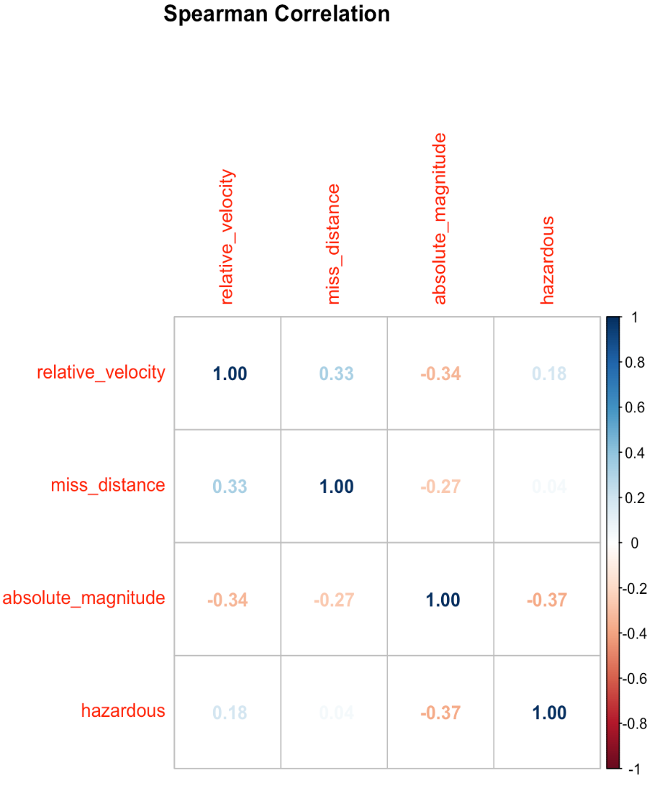
Feature Selection: Spearman correlation matrix

Slide 8
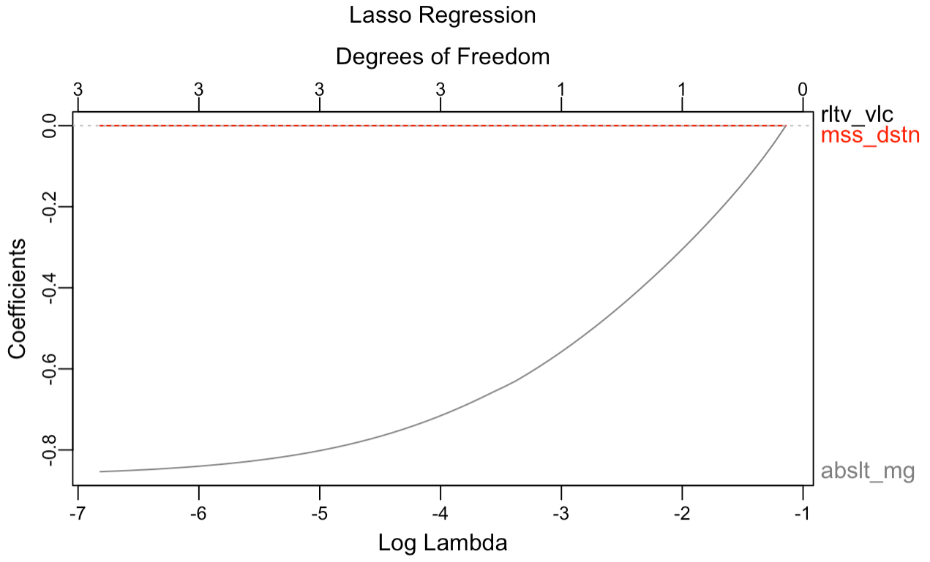
Feature Selection: Lasso regression

Slide 9
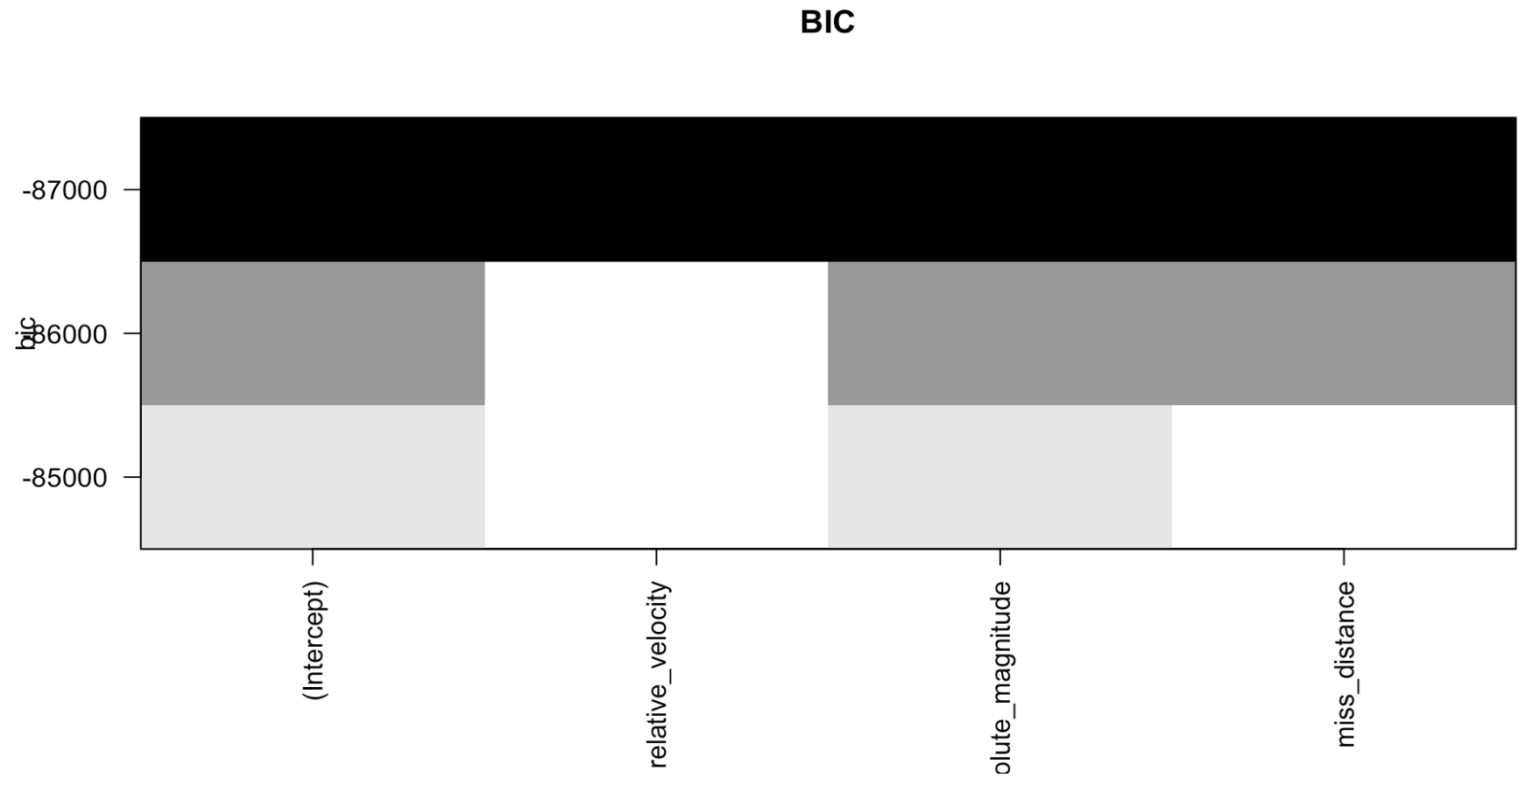
Feature Selection: BIC

Slide 10
Splitting and Sampling

Slide 11
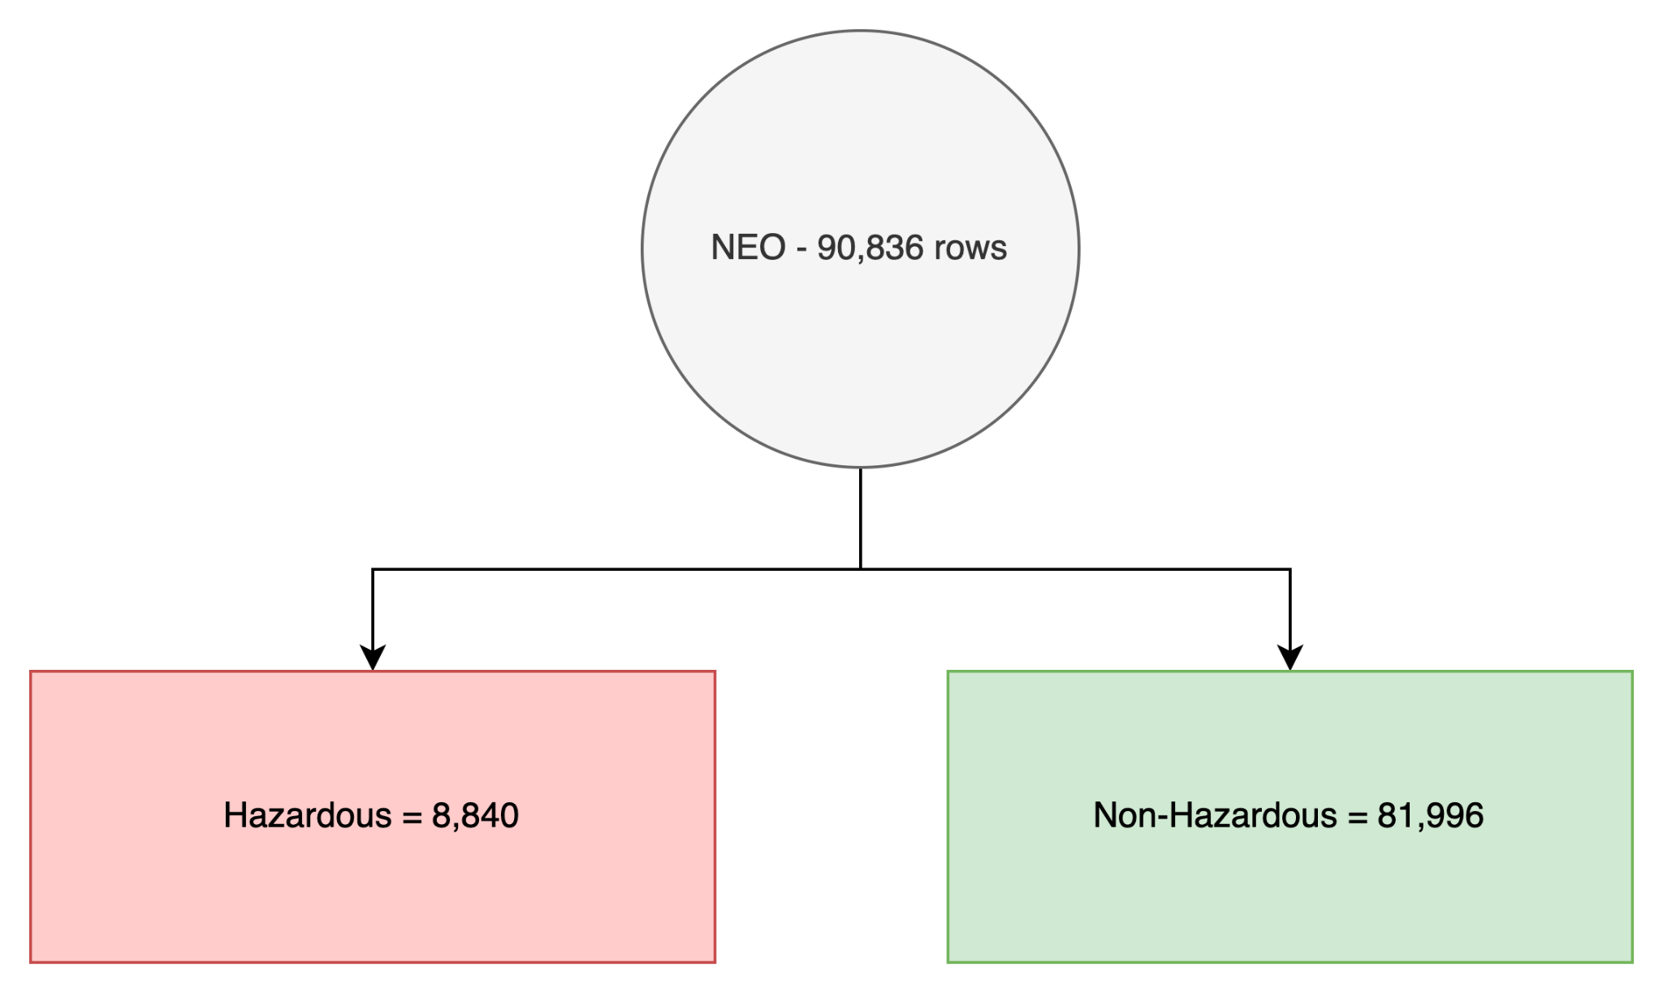
Dataset:

Slide 12
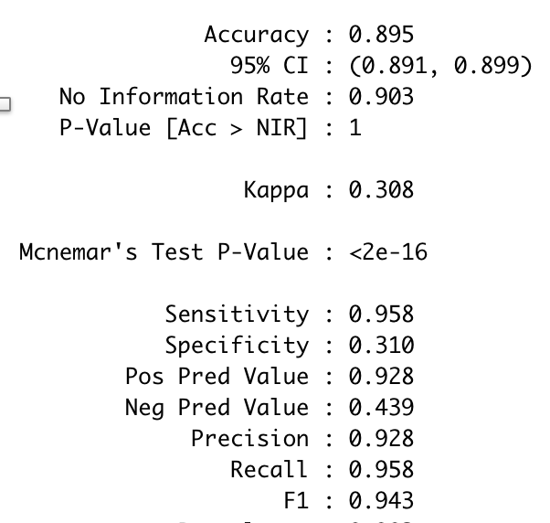
Split into Train and Test
Train = 75% = 68,127
Hazardous = 6,642
Non-hazardous = 61,485
Test = 25% = 22,709
Hazardous = 2,198
Non-hazardous = 20,511

Slide 13
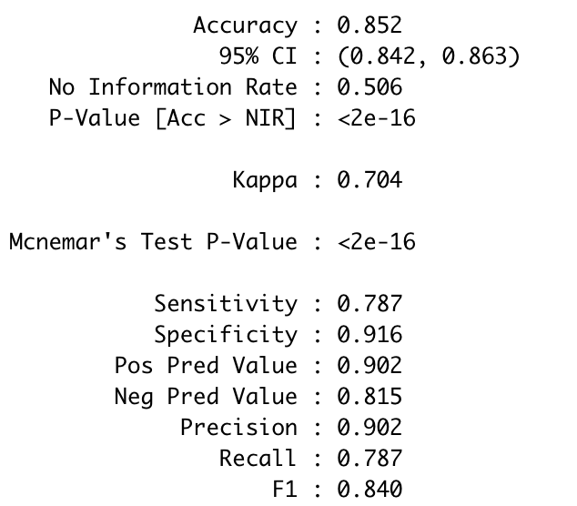
2) Downsampling
Train = 75% = 13,260
Hazardous = 6,602
Non-hazardous = 6,658
Test = 25% = 22,709
Hazardous = 2,238
Non-hazardous = 2,182
PROBLEM?

Slide 14
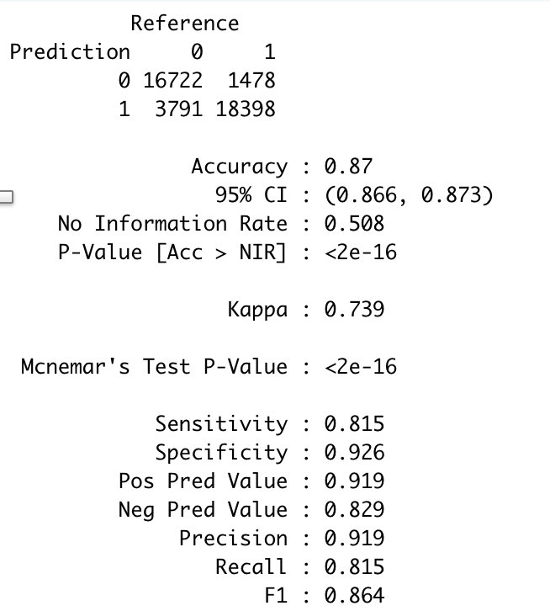
3) SMOTE
Total = 161,556
Train = 75% = 121,167
Hazardous = 59,684
Non-hazardous = 61,483
Test = 25% = 40,389
Hazardous = 19,876
Non-hazardous = 20,513

Slide 15
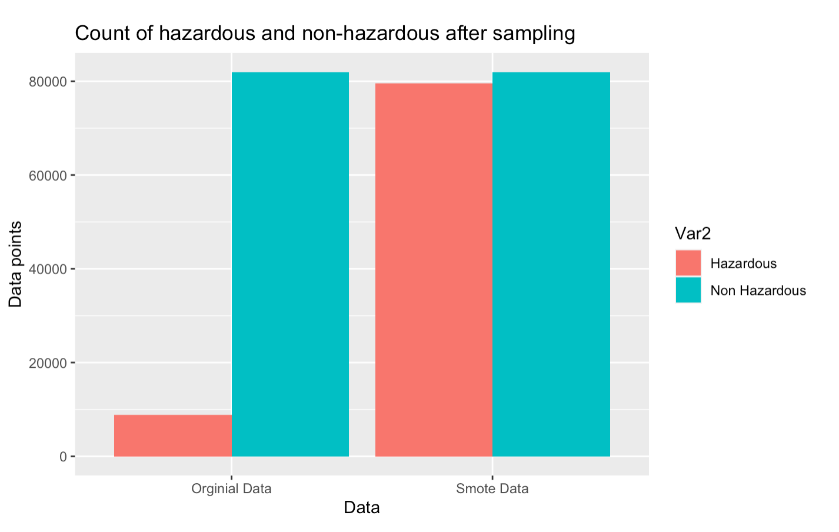
Original Data vs SMOTE data
 | Accuracy | Specificity | Recall
Unbalanced | 89.9% | 30.3% | 96.3%
SMOTE | 87.5% | 94% | 81.1%

Slide 16
Models

Slide 17
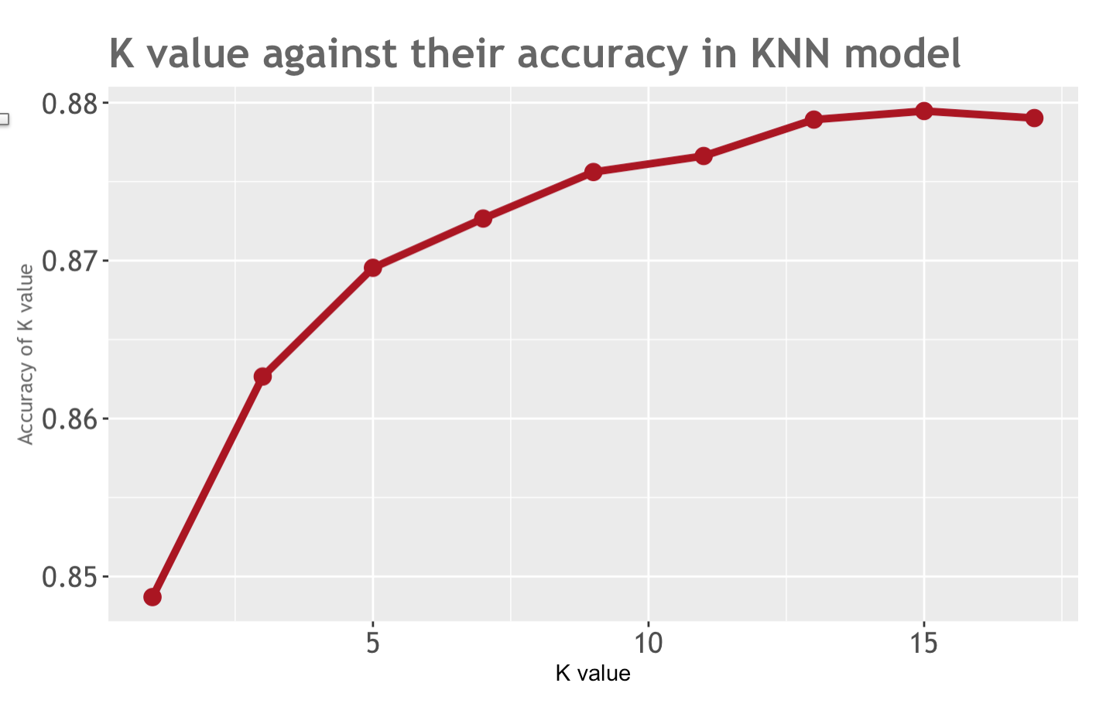
Model 1: K-Nearest Neighbors
9

Slide 18
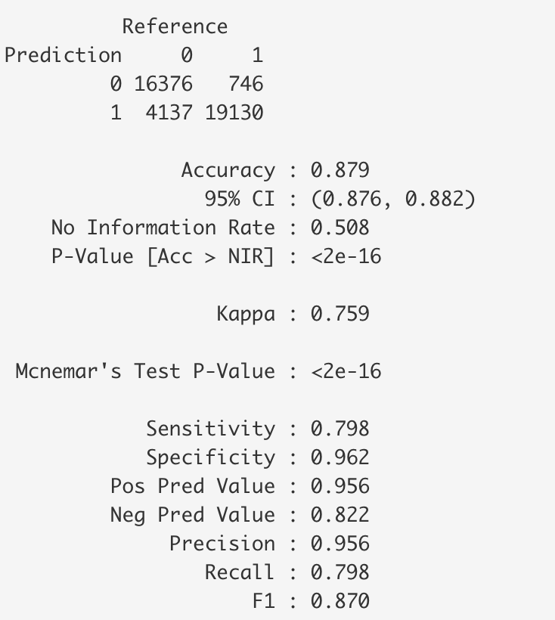
Model 1: KNN Evaluation

Slide 19
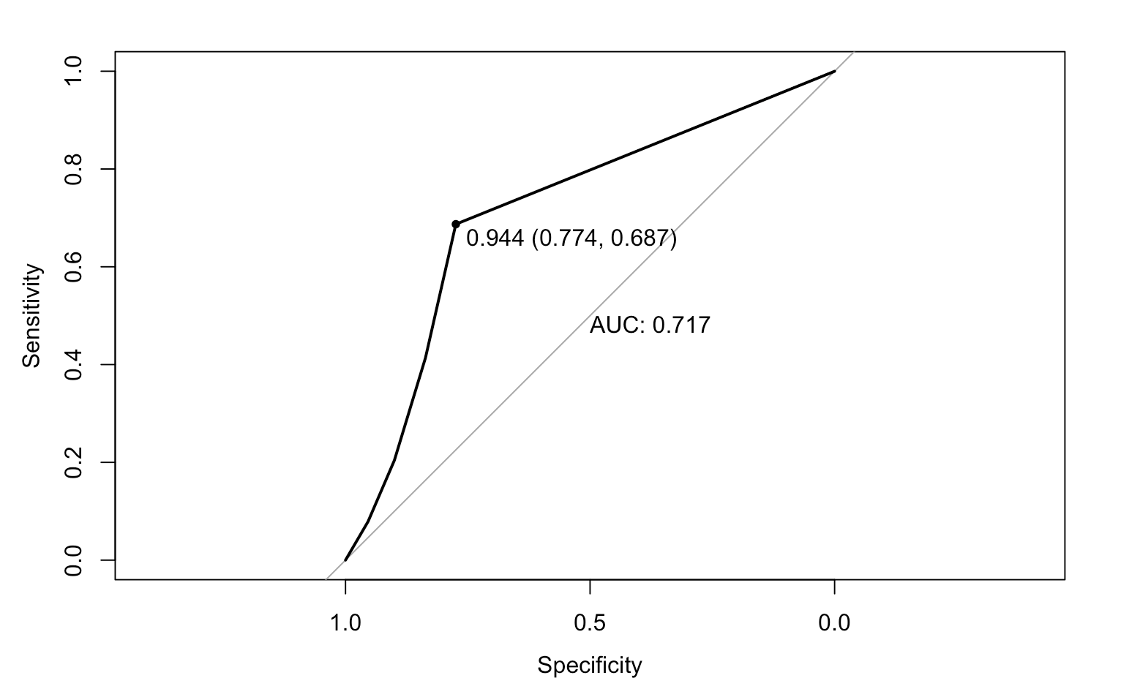
Model 1: KNN Evaluation

Slide 20
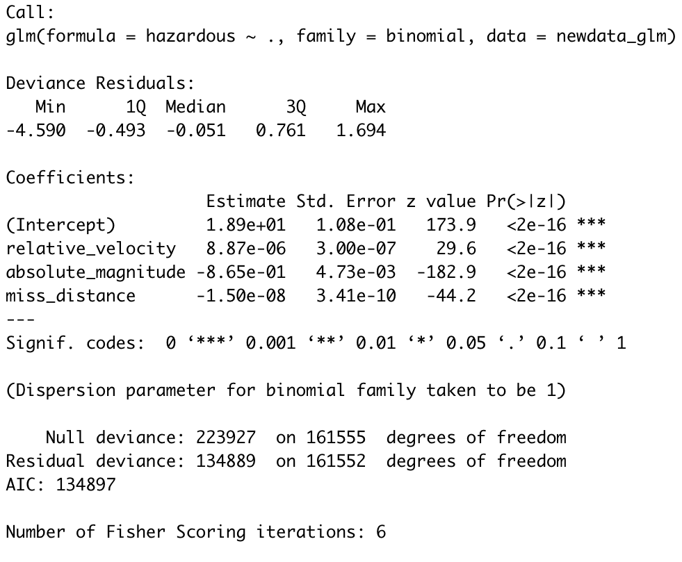
Model 2: Logistic Regression
A neo’s odds of being hazardous are likely to increase:
If its relative_velocity is high.
If its absolute_magnitude is small.
If its miss_distance is small.

Slide 21
Model 2: Logistic Regression Evaluation
Accuracy = 85.30%
Sensitivity (TPR) = 80.73%
Specificity (FPR) = 91.16%
Precision = 92.14%
Pred. Actual | 0 | 1
0 | 64,502 | 6,251
1 | 17,494 | 73,309

Slide 22
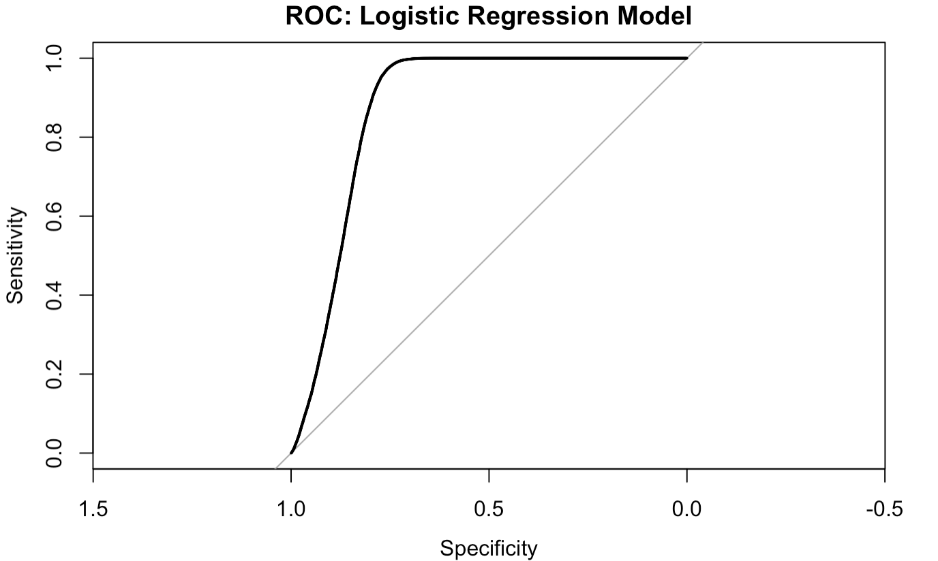
Model 2: Logistic Regression Evaluation
AUC = 0.877
McFadden (pseudo R²) = 0.40

Slide 23
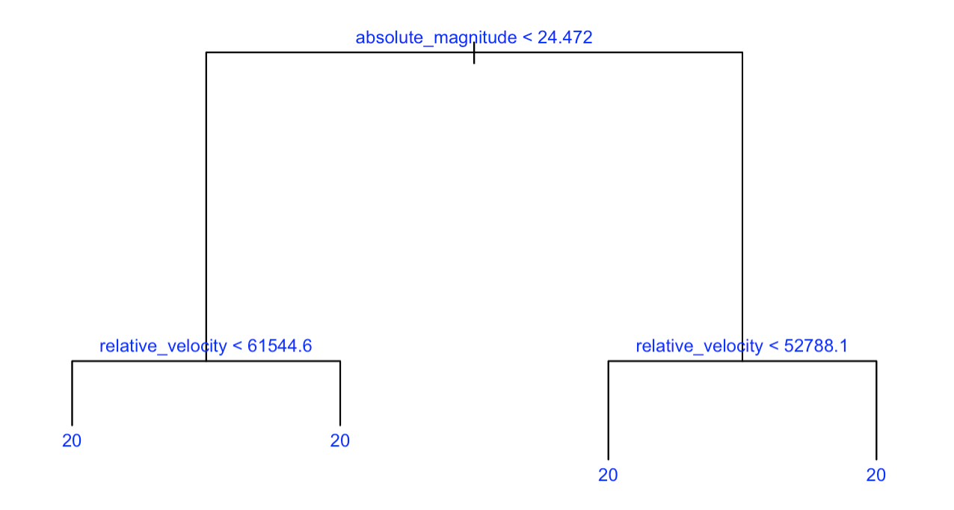
Model 3: Classification Tree

Slide 24
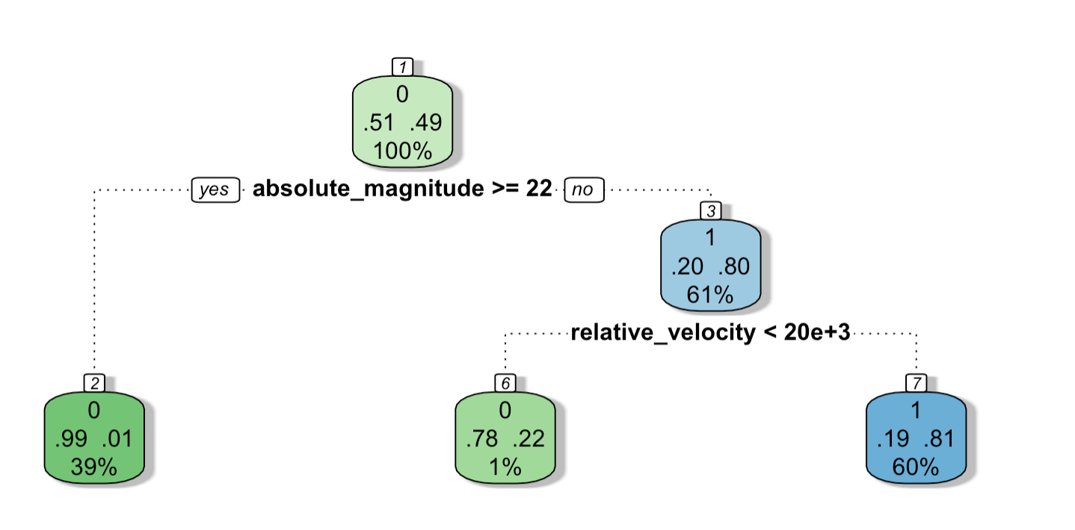
Model 3: Classification Tree (rpart)

Slide 25
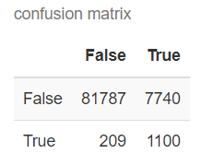
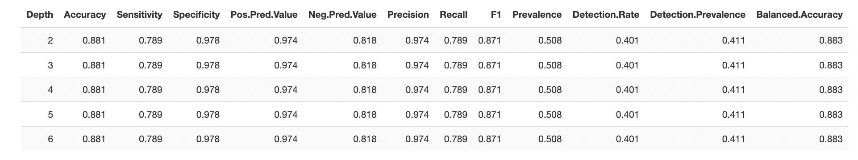
Model 3: Evaluation

Slide 26

Conclusion
Model | Accuracy | Specificity (FPR) | Sensitivity/Recall (TPR) | AUC
Model 1: K-NN | 87.9% | 96.2% | 79.8% | 0.717
Model 2: Logistic Regression | 85.30% | 91.16% | 80.73% | 0.877
Model 3: Classification Tree | 88.1% | 98.9% | 77.6% | 0.781
Notes:
DISADV OF KNN, TREE
RECALL IS AN IMPORTANT METRIC
ADV OF GLM

Slide 27
Sample predictions
Rel_velocity | Abs_magnitude | miss_distance | Predicted Prob.
17.38 km/s | 17.1 | 1.2417e+8 a.k.a 125 M. Km | 90.10%
21.80 km/s | 18.02 | 2.543e+8 a.k.a 250 M. Km | 36.80%
https://www.spacereference.org/asteroid/2022-ap7
https://www.spacereference.org/asteroid/2017-cm

Slide 28
Thank you!

Slide 29
References
https://www.spacereference.org/asteroid/2022-ap7
https://www.spacereference.org/asteroid/2017-cm
https://cneos.jpl.nasa.gov/about/neo_groups.html

